Slide 1
Application19.6
Minimum Ratio Asymmetric Data Scaling
Network Optimization Applications 19.6 by 成大工資管

Slide 2
Content
Introduction
  Data scaling
  Minimum Ratio Asymmetric Data Scaling
Related problems
Solution methods
Network Optimization Applications 19.6 by 成大工資管

Slide 3
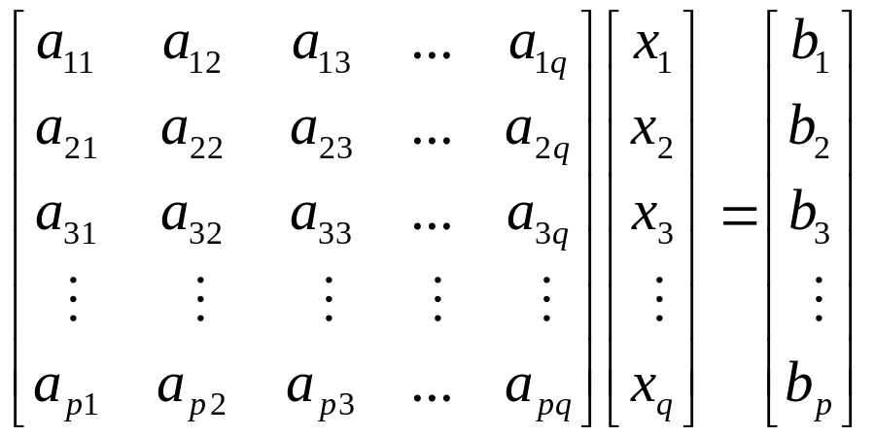
Introduction
Data scaling
objective Minimize Cx
subject to AX=B，X≧0
We incur round-off errors, because computers perform in floating-point arithmetic.
We hope that…
Network Optimization Applications 19.6 by 成大工資管

Slide 4
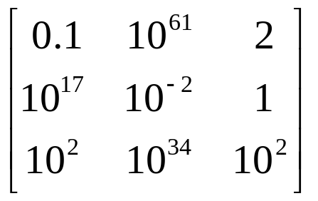
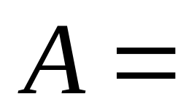
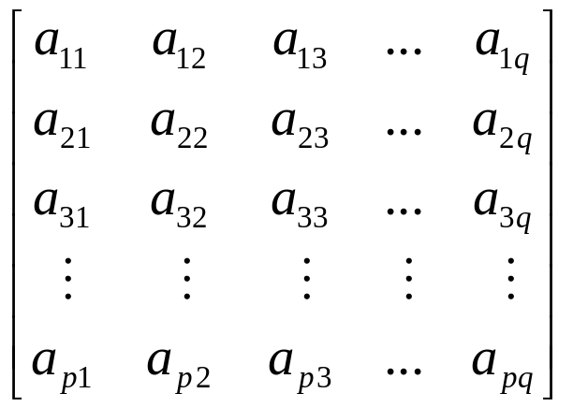








Introduction
Exp.
Network Optimization Applications 19.6 by 成大工資管

Slide 5
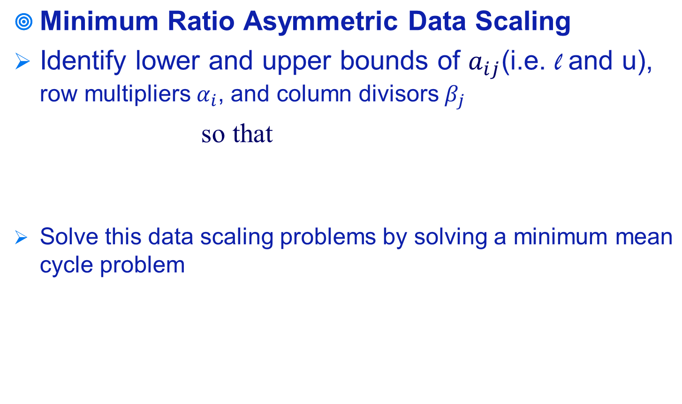
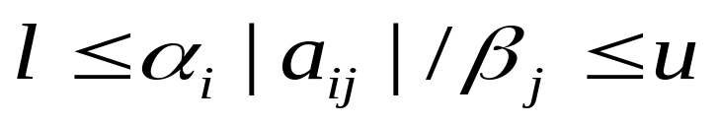
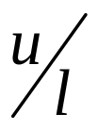
Introduction
for each i=1,…,p, and j=1,…,q,
with the smallest possible ratio .
Network Optimization Applications 19.6 by 成大工資管

Slide 6
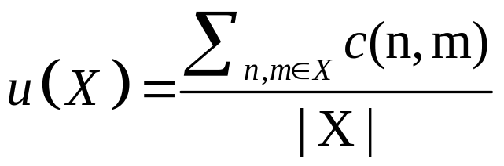
Related problem
Minimum mean cycle problem
Given a strongly connected graph G = (n,m) , with arc weights c
Let |X| be the number of arcs on the cycle
For any cycle X, the mean value of X is defined by
Network Optimization Applications 19.6 by 成大工資管

Slide 7
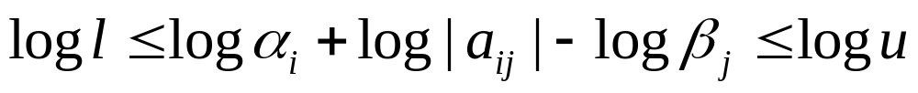

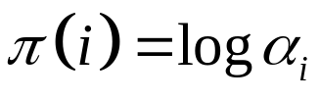
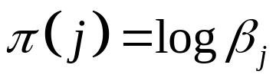



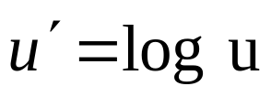
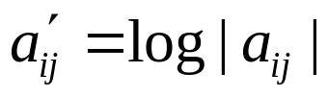
Solution methods
Reference: Application 19.5 Asymmetric Data Scaling with lower and upper bounds
Take the logarithms of both sides
Let
0
0
,for every i=1,…,p, and j=p+1,…,p+q.
Network Optimization Applications 19.6 by 成大工資管

Slide 8
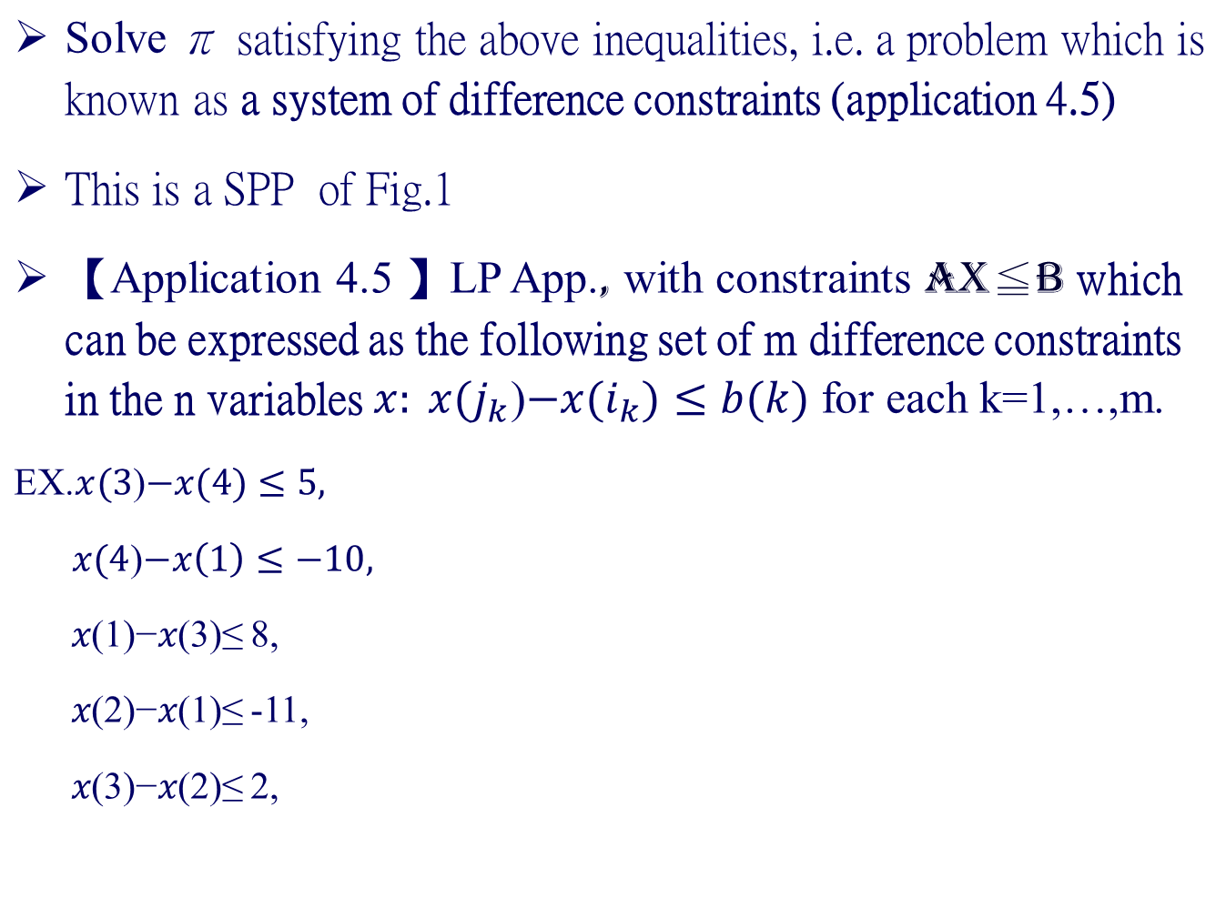
Solution methods
5
4
3
Negative cycle 1-2-3 of length －1,
8+2-11=－1
∴No solution
8
2
-10
-11
1
2
Network Optimization Applications 19.6 by 成大工資管

Slide 9
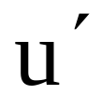
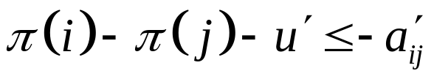
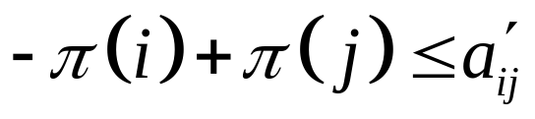



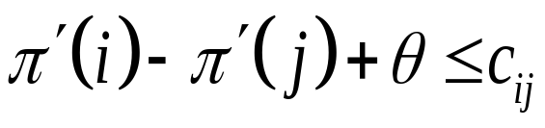

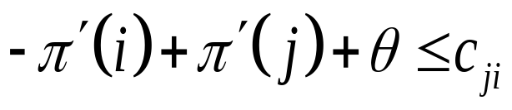
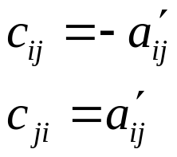
Solution methods
Minimum Ratio Asymmetric Data Scaling
Minimize
Subject to
To simplify, we redefine the variables.
Minimum
Subject to
－θ
－θ
Minimum mean cycle problem
Network Optimization Applications 19.6 by 成大工資管

Slide 10
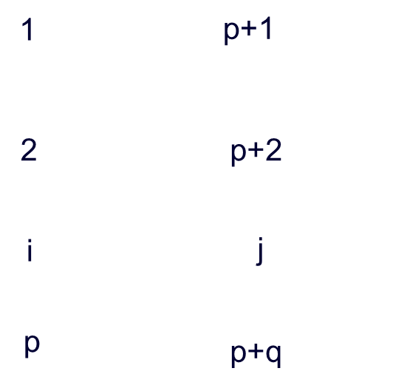



Feasible solution
We can solve the minimum mean cycle problem as a SPP on the network shown in Fig 1.
C_{ji}-θ
Fig.1
Network Optimization Applications 19.6 by 成大工資管

Slide 11
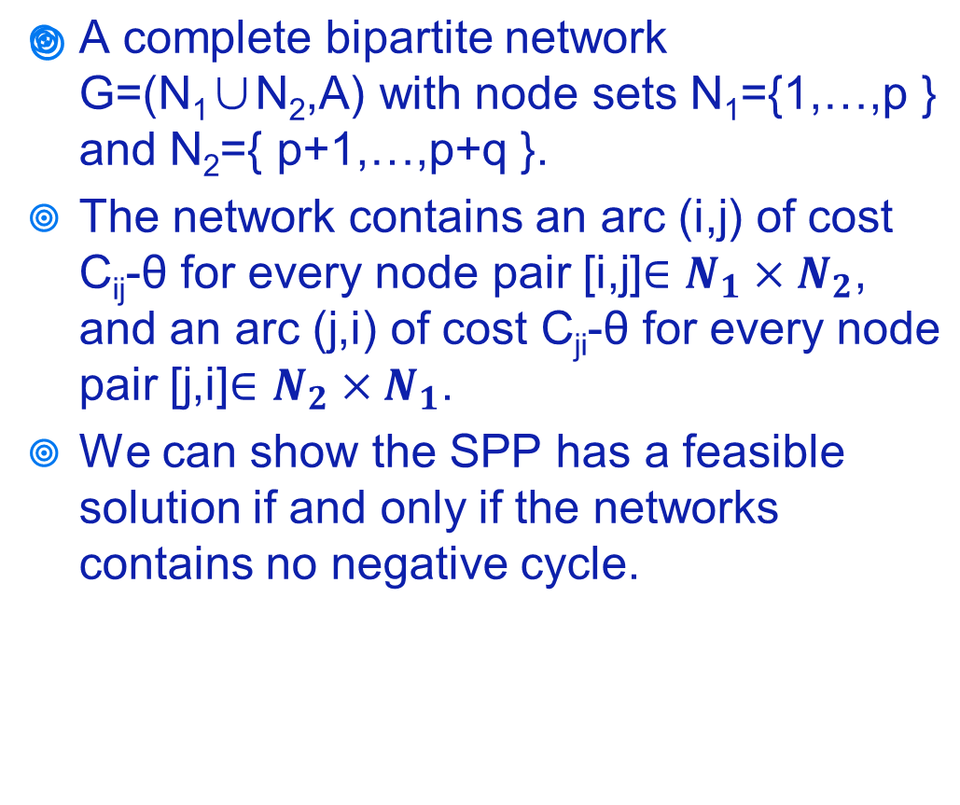
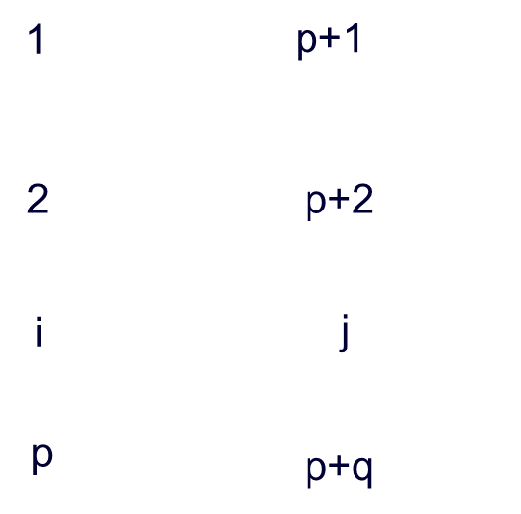
Feasible solution
C_{ji}-θ
Fig.1
Network Optimization Applications 19.6 by 成大工資管

Slide 12
Thanks for your listening!!!
Q&A
Network Optimization Applications 19.6 by 成大工資管

